Slide 1

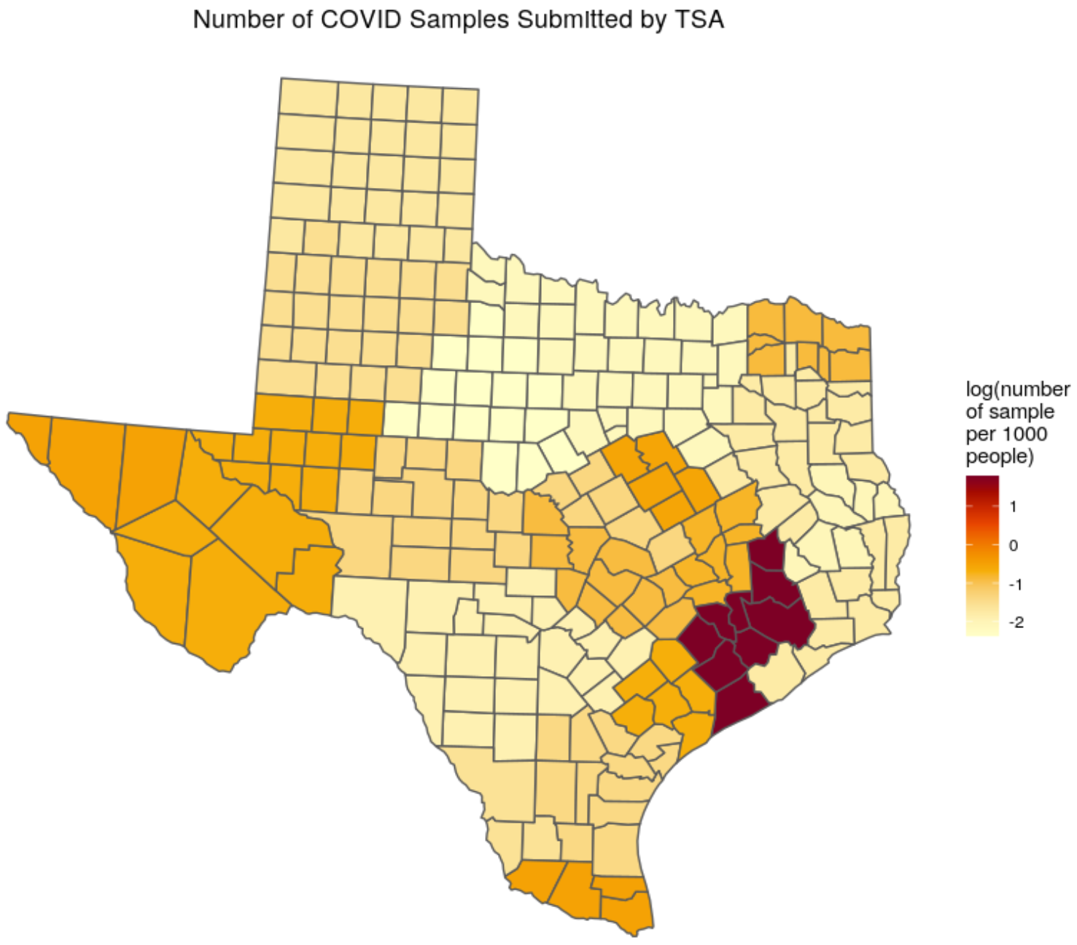
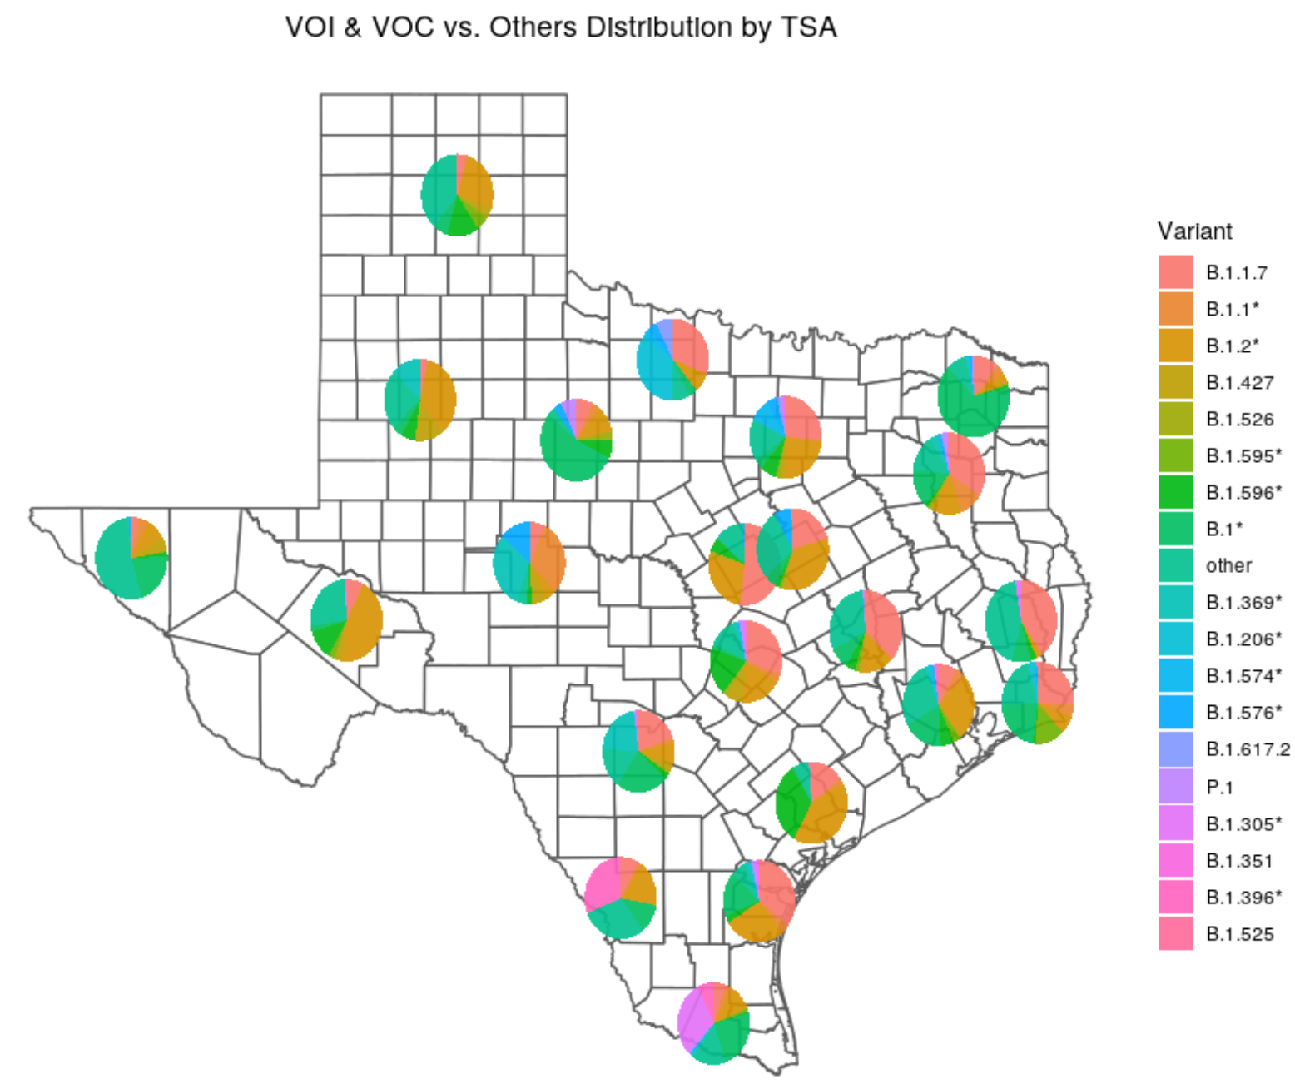
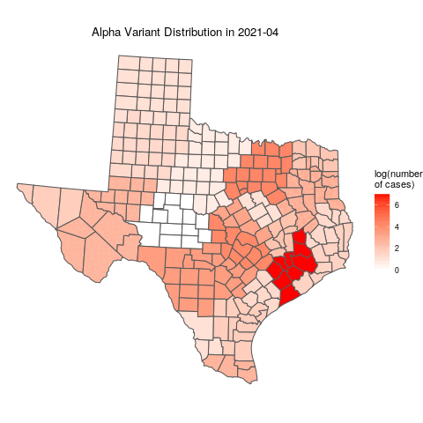
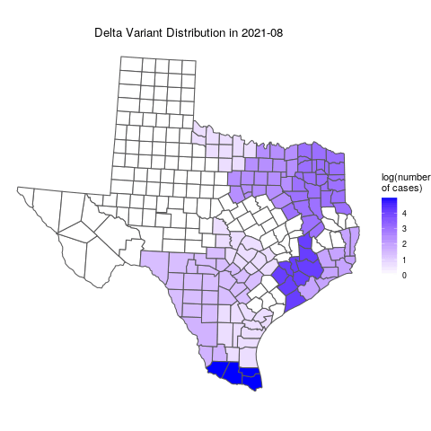
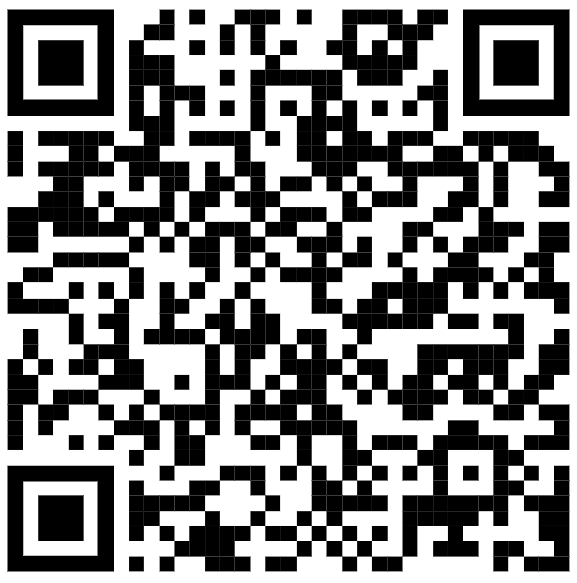
Tracking Spread of COVID Variants Across Texas
Using Animations
Wenxuan Zhou¹, Amelia Baumhart Leveille¹, Lokesh Pugalenthi¹, Dhivya Arasappan²
¹College of Natural Sciences; ²Center for Biomedical Research Support
Background
Conclusion
Severe acute respiratory syndrome coronavirus‑2 (SARS‑CoV‑2) is a novel RNA virus that is responsible for the COVID‑19 pandemic. Genetic variants of SARS-CoV-2 have been emerging and circulating the world throughout the pandemic, and it is important to classify and monitor these variants.
The animations were created using an R script. To view the full animation, scan the QR code
The script can be reused to track new variants, and the analysis is not very computationally intensive
Our modeling of COVID variant phylogenetics could help reveal the transmission patterns of COVID variants, which will aid in predicting the rise of new strains and its transmission in the future
Figure 1. Number of COVID Samples submitted by TSA
Figure 2. Variant Distribution by TSA
Research Questions
What is the variant prevalence across the state for major variants?
What is the transmission path of the Alpha and Delta variants in Texas?
Acknowledgments
I would like to express my gratitude to Dr. Spencer Fox and Anna Battenhouse for their support throughout the course of this project. Funding was provided by TIDES FRI Summer Research Fellowships.
Methods and Materials
Data Source:
Strain information and location data from GISAID
Location data was grouped into Trauma Service Areas (TSA)
Methods:
Hypergeometric test
Animations
Figure 3. Number of Alpha Cases by TSA in April 2021
(for full animation, scan the QR code)
Figure 4. Number of Delta Cases by TSA in August 2021
(for full animation, scan the QR code)
References
Results
CDC. “Coronavirus Disease 2019 (COVID-19).” Centers for Disease Control and Prevention, 11 Feb. 2020, https://www.cdc.gov/coronavirus/2019-ncov/variants/variant-info.html.
GISAID, https://www.gisaid.org/.
Islam, M. Rafiul, et al. “Genome-Wide Analysis of SARS-CoV-2 Virus Strains Circulating Worldwide Implicates Heterogeneity.” Scientific Reports, vol. 10, no. 1, Dec. 2020, p. 14004. DOI.org (Crossref), https://doi.org/10.1038/s41598-020-70812-6.
The Wilke Lab, https://wilkelab.org/.
The Alpha variant became prevalent in Texas from January to April 2021
The Delta variant occurred in Texas in April and spread quickly to East Texas
Both variants were found first in East Texas
At the early stage of both variants’ prevalence, many cases were found in TSA Q and TSA E, which might be due to the large number of international traveling in Houston and Dallas

